Slide 1
SINHALA SPELL CHECKER
Team හෙළබස
SUPERVISOR
Prof. Gihan Dias
EVALUATORS
Dr. Surangika Ranathunga
Mr. Buddhi Ayesha
GROUP 32
150185P - K.P.K. Geesara
150211U- G.H.C.S Hasoga
120690G - P.A.K.S. Weerasinghe

Slide 2
INTRODUCTION

Slide 3
INTRODUCTION
People create millions of textual documents using Microsoft Office Word daily.
Spell checking applications are important part of several fundamental day today applications
Word processors
Machine Translation systems
Automatic Speech Recognition Systems
Text to Speech Systems
Although there are a lot of spelling checking applications for resourced languages like English, very little attention has been given to languages like Sinhala.
Morphological richness
Resource scarcity

Slide 4
PROBLEM STATEMENT
Sinhala is an official Language of Sri Lanka and used by more than 17 million people
As many government and private documents are written in Sinhala on a word processor, there is a need for a Sinhala Spell checker
Three types of Spelling errors
Typographical errors
Conceptual errors (the user used an incorrect spelling)
Contextual based errors
Currently developed spelling checking engines for Sinhala language have various limitations
Hunspell
Microsoft word
Subasa

Slide 5
Research Objectives
Main goals
Check the spelling of a given Sinhala document.
Provide suggestions of correct words to the words that are identified as misspelled by the system.
Our main objectives
Develop a complete noun morphology analyser for sinhala nouns using FOMA tool.
Develop a Sinhala root words extractor.
Generate a Sinhala dictionary of about 1 million spell corrected sinhala unique words
Develop a word preprocessor.
Develop data models for morpheme stemming and suggestions generating.
Develop an interactive web application for spell checking using above resources.
Notes:
Train a morfessor model for sinhala words for morpheme stemming and evaluate the model using a test set.
Train a fasttext model to output suggestions for a given misspelled word.
Develop an interactive web application for spell checking using above resources.

Slide 6
RELATED WORK

Slide 7
RELATED WORK
History
The first research has been done in 1961 by Les Earnest who was a former computer scientist.
In 1971 Ralph Gorin, an undergraduate student developed the first true spelling checker.
Reality of Spell Checking
Spelling error checking and error correction accuracies of the majority of European and American languages have exceeded 95%.
For Indo-Aryan languages like Sinhala, Malayalam, and Telugu, the accuracies are under 80% -85%.

Slide 8
RELATED WORKS CONT.
The Two Main Areas
Spelling error detection
Spelling error correction
Multiple Ways to Cover Them
Error detection
Dictionary lookup, n-gram analysis, morphology and rule based etc..
Error correction
Minimum edit distance, similarity key, Rule-based methods, Neural Network etc..

Slide 9
RELATED WORKS CONT.
Different Approaches to Come Up with Solutions
When developing spelling checking engines, the approaches can be mainly categorized into three parts
Data-driven approach
Morphology/Dictionary based approach
Machine learning-based approach

Slide 10
RELATED WORKS CONT.
Data Driven Approaches
A data-driven approach is one of the good approaches used in developing spelling checking mechanisms for various types of languages including Sinhala.
A Data-Driven Approach to Checking and Correcting Spelling Errors in Sinhala, 2010[1]
Subasa spell checker
Focused on three common spelling errors
Subasa 2nd version with more improvements,2012[2]
Improved accuracy
Generated Sinhala word suggestions using minimum edit distance
Notes:
The Pronunciation and Orthography of Aspirated and Unaspirated Consonants.
Retroflex and dental letter confusion.
The Pronunciation and Orthography of the Retroflex and Palatal Sibilants

Slide 11
RELATED WORKS CONT.
More Data Driven Approaches
Data Driven Approach to Sinhala Spell Checker and Correction. 2018[3]
Used similar structure, similar-sounding letters, and minimum edit distance
Provided solution to detect contextual errors
Improved error detection capability of spelling checkers based on data driven approach

Slide 12
RELATED WORKS CONT.
Morphology/Dictionary based approaches
Mainly focussing on error detection .
The dictionary-based approach is the oldest approach.
Morphology based spelling checkers are also very similar to dictionary-based spelling checkers.
Punjabi Spell Checker Using Dictionary Clustering, 2015[4]
Deviated from the traditional method
Used dictionary clusters based on nouns, verbs, adjectives, and pronouns
Improved performance by reducing dictionary size.

Slide 13
RELATED WORKS CONT.
More morphology/Dictionary based approaches
A Telugu Morphological Analyzer, 2011[5]
Based on morphological rules and Sandhi splitting rules.
Contained two major sections
A well-defined set of routines for scanning the submitted text document and identifying valid words in the text.
An algorithm for comparing the unrecognized words and word parts in the text against a known and carefully-defined list of variant spelled words and word parts.
Achieved 95% ~ 97% accuracy
Notes:
Algorithm to identify valid words in the submitted text.
Algorithm to analyze unrecognized words

Slide 14
RELATED WORKS CONT.
More morphology/Dictionary based approaches
Defining the Golden Standard Definitions for the Morphology of Sinhala Words
Research conducted by researchers at University of colombo school of computing on sinhala morphology.
Shows how sinhala nouns and sinhala verbs can be classified on how these words are inflected and their morphological information.
According to their research sinhala nouns can be categorized into 26 categories.
Notes:
Have categorized 11000 sinhala nouns according to above standards.

Slide 15
RELATED WORKS CONT.
Machine learning based approaches
The latest approach to solve difficulties related to spelling checking for any language.
One of the best methods that can be used for languages with enough data.
A deep learning approach for Malayalam morphological analysis at character level,2018[6]
Used Sandhi splitting
Deep learning based solution including three unique systems
Long Short-Term Memory (LSTM)
Recurrent Neural Network (RNN)
Gated Recurrent Unit(GRU)
Achieved 97.8%,98.08%,and 98.16% accuracies

Slide 16
RELATED WORKS CONT.
Machine learning based approaches
Deep learning based spell checker for Malayalam language, 2018[7]
Has two main processes to handle both error detection and correction
Based on Long Short-Term Memory(LSTM) neural network
Measured accuracy using F1-score
Used candidate word suggestion method to error correction

Slide 17
RELATED WORKS CONT.
Machine learning based approaches
Evaluating a Machine Learning Approach to Sinhala Morphological Analysis
A team of researchers at the University of Colombo school of computing has conducted research [9] and evaluation on how to use popular machine learning algorithm used in morpheme segmentation, Morfessor.
They have used two sets of different datasets to train morfessor model and evaluate the results.
Full distinct word list extracted from a 10 M corpus
Distinct list of words with frequencies
Overall this Morfessor algorithm has predicted stemming for more than 50% accurately according to this research.
Notes:
Each dataset was turned in to english and trained the model. ( Romanizing)
According to their research this algorithm performed better predicting noun stems than verbs.
Also accuracy of the model which was trained using second data set has gained significant improvement on accuracy on stemming
Tested using data on Defining the Golden Standard Definitions for the Morphology of Sinhala Words

Slide 18
RELATED WORKS CONT.
Morfessor : Toolkit for statistical morphological segmentation
Morfessor is a family of probabilistic machine learning methods.
Morfessor can be used to analyze morphological segmentation for most of the Indo-Aryan languages like Sinhala.
Semi-supervised learning is used to develop training models.
Root of a given word and inflections can be identified using morfessor.
Notes:
Morfessor is a family of probabilistic machine learning methods for finding the morphological segmentation from raw text data.

Slide 19
METHODOLOGY

Slide 20
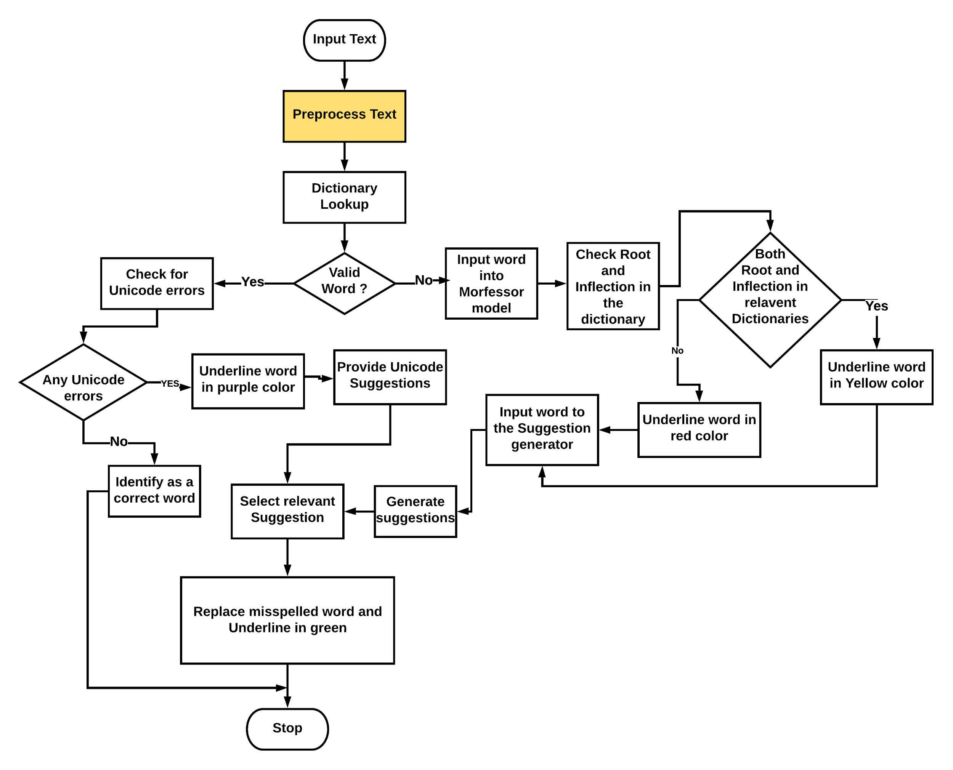

Slide 21
Word pre-processing model
Preprocessing text is important because there can be formatting and Unicode errors in the input text.
This Word pre-processing model consists of following sub modules
Word Tokenizer
Unicode cleaner
Word Formatter
Notes:
it is vital to have a word pre-processor for our spell checker to correct these types of errors. Otherwise, both spelling error detection and correction processes will be completely wrong.

Slide 22
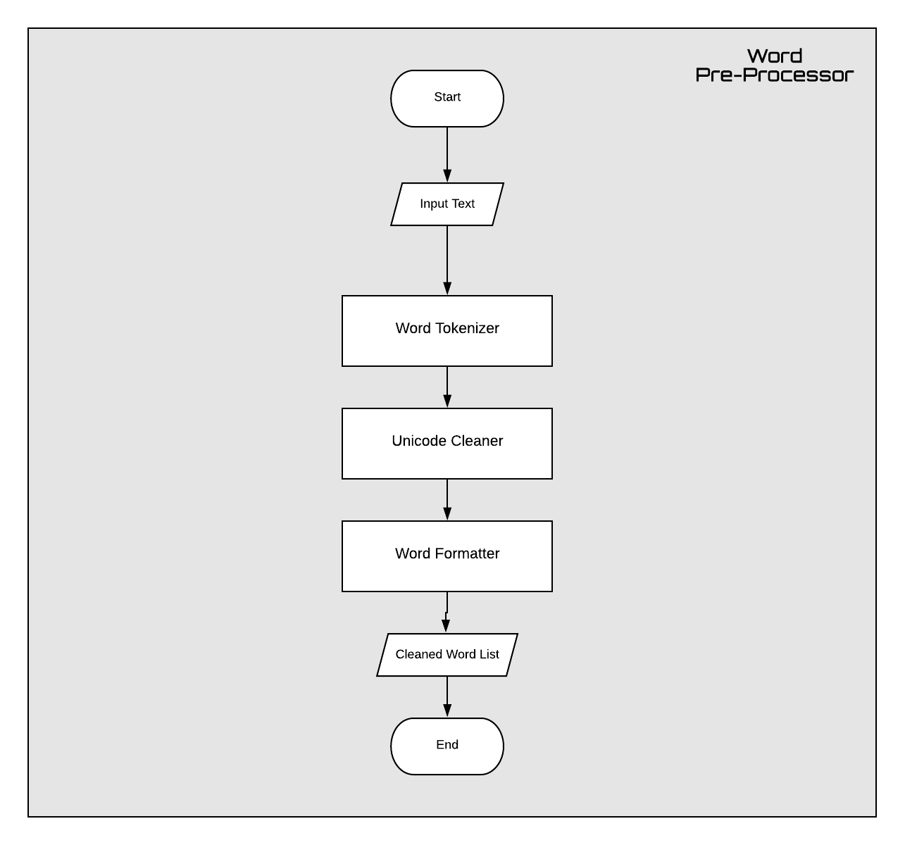

Slide 23
Word Tokenizer
Tokenization is the process of breaking a stream of text up into words, paragraphs, symbols or other meaningful elements called tokens.
Before feeding to the spell checker, an input text should be split into separate Sinhala Words. Therefore, a Sinhala word tokenizer is included in the word pre-processing unit.
Specially designed regular expression rules which are based on Sinhala Unicode range were used to develop the tokenizer for our spell checker
“/\s*(?<start_part>(–|~|`|!|@|#|$|%|^|&|\*|\(|\)|{|}|\[|\]|;|:|\"|'|<|,|\.|>|\?|\/|\\|\||-|_|\+|=)*)(?<sin_word>[\u0d80-\u0dfe\u200d\u200c\u200b]+)(?<end_part>(~|`|!|@|#|$|%|^|&|\*|\(|\)|{|}|\[|\]|;|:|\"|'|<|,|\.|>|\?|\/|\\|\||-|_|\+|=)*)\s*/g”

Slide 24
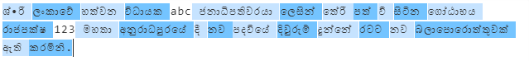
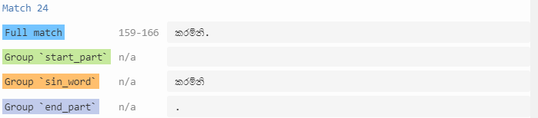
Word Tokenizer

Slide 25
Unicode Cleaner
Unicode errors are one of the common types of errors found in any word text. These errors are not problematic when words are graphically rendered.
But these errors will cause some problems when developing an application like a spell checker.
In most cases, Unicode errors are occured due to having invisible character joiners such as zero width joiner (\u200d). These types of unicode characters helps to change the appearance of two or more visible characters into a combined version.
It is necessary to clean these Unicode errors before feeding to spell checker or suggestion generator. So, all the data used in the spell checker and the suggestion generator are cleaned through this Unicode cleaning process.

Slide 26
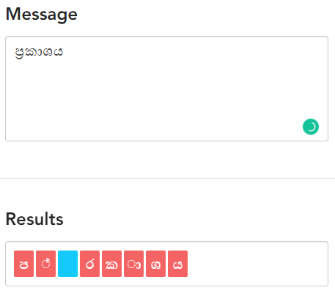
Unicode Cleaner
Below shown is an instance where zero width joiner (\u200d) is actually needed and used. Zero width joiner is represented in blue color in the following diagram.

Slide 27
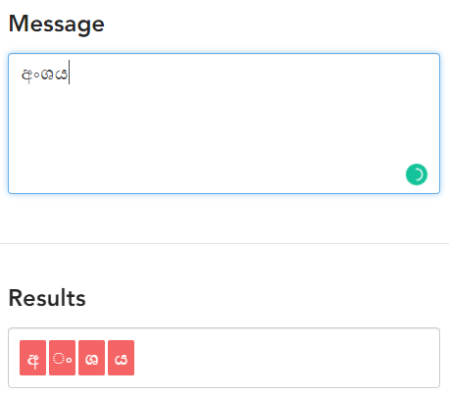
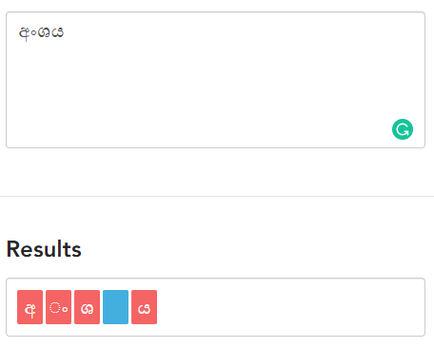
Unicode Cleaner
If a writer accidently let these invisible word characters to be placed in the wrong places then the entire word will become a wrong word in character level.
Correct character sequence of අංශ‍ය Incorrect character sequence of අංශ‍ය

Slide 28
Word Formatter
Sometimes two different character sequences might be rendered into a single word by the word rendering engine. This behavior is not an error at all because some people prefer different writing styles.
It is necessary to convert all the words into a specific Unicode format before using data for creating Sinhala dictionary or checking spelling error of an input text.
If we have multiple formats in the word dictionary and Input text, It will cause to reduce the accuracy of the spell checker because same word in the input text and dictionary won't match because of different formats.

Slide 29
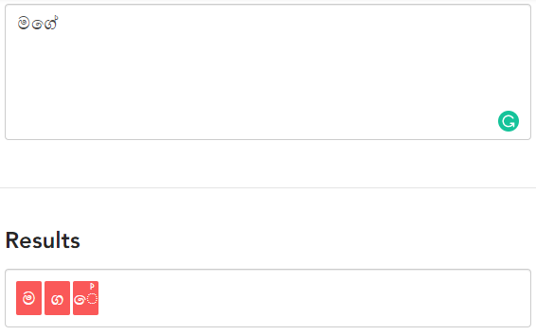
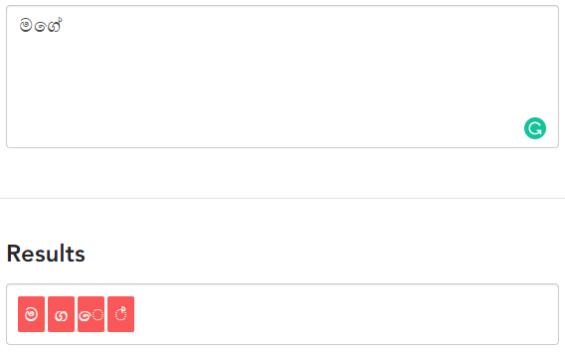
Word Formatter
Following are examples for two different Formats for the same word.
First Format Second Format

Slide 30
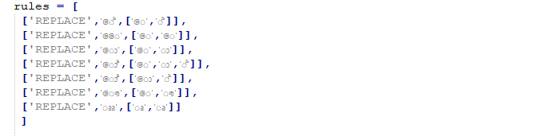
Word Formatter
The word format used in this module, changes character sequence of a Sinhala word according to the following rules. Also some word writing styles such as bonding words are converted into non-bonding word formats.

Slide 31
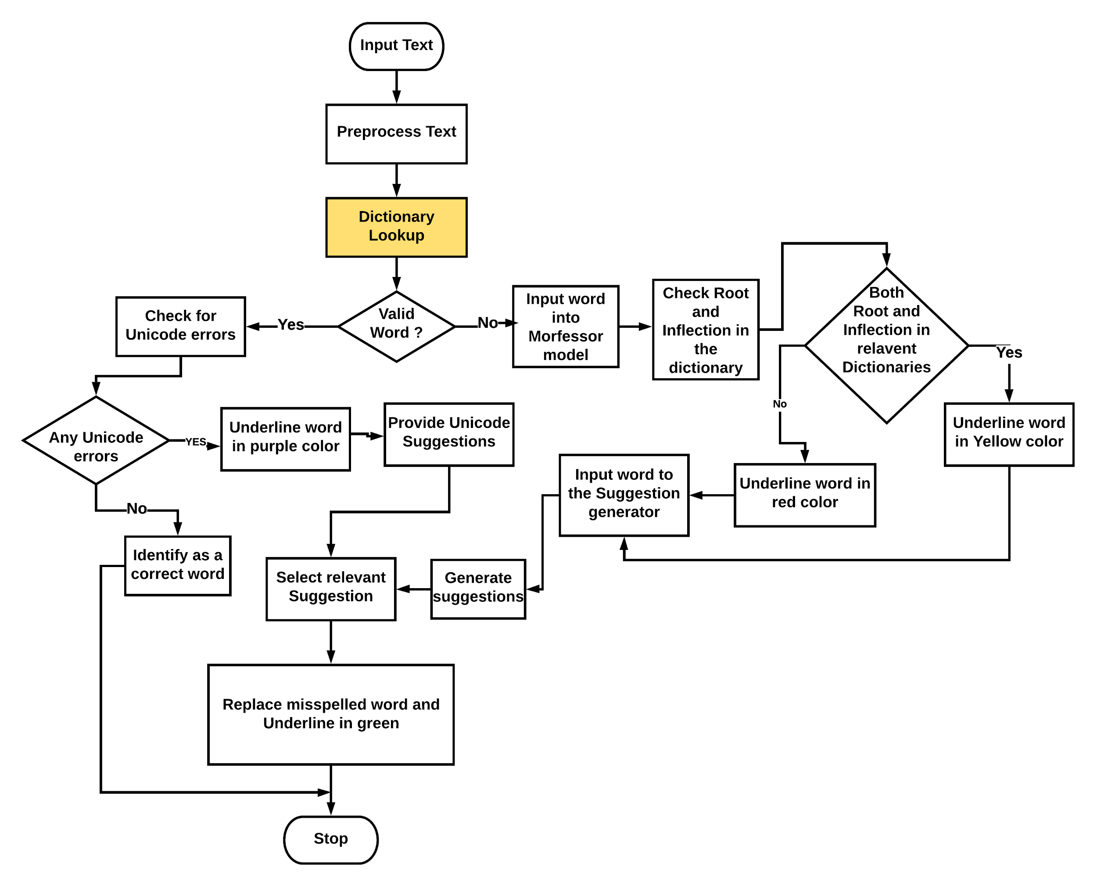

Slide 32
Dictionary
We created a Dictionary of 1M Unique words. That dictionary mainly consist of
600K Unique words generated from the noun morphology analyser developed by our team.
400k Unique words found from different spell corrected sources.
Words generated from verb morphology analyser
Spell corrected corpus in DMS
UCSC 400K unique word corpus
Hunspell Dictionary
We used Python Dictionary data structure to store these words because lookup time complexity in the Python dictionary is O(1) which does not depend on the length of the dictionary.

Slide 33
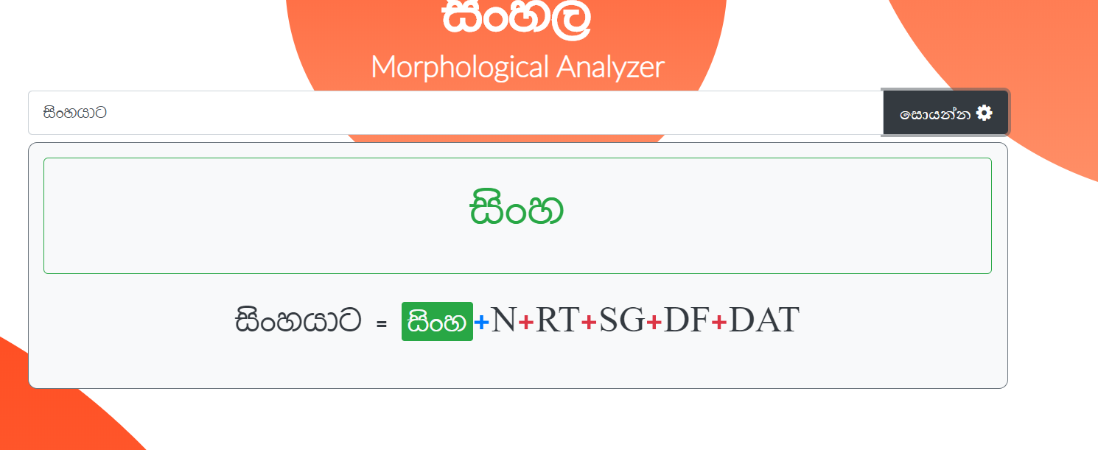
Noun Morphology Analyser
We developed a noun morphological analyzer component as a part of our project.
When we input a noun into this component it will identify the root word of the given word and the inflected parts of the given word.

Slide 34
Noun Morphology Analyser
We developed this morphological analyzer component using a C language library called FOMA
In Foma Lexicon files we have to list root words that inflect in the same way in the same class and the rules (+N+RT+SG+DF+DAT: යාට#) that are used when the inflected part is joined with the root word.
We used data from an earlier research[15] done by researchers in UCSC where we were able to collect 11000 sinhala noun root words and their inflections.
We were able to mainly identify 26 different classes of nouns on how they inflect. Ex- කොල්ලා, බල්ලා in the same class.

Slide 35
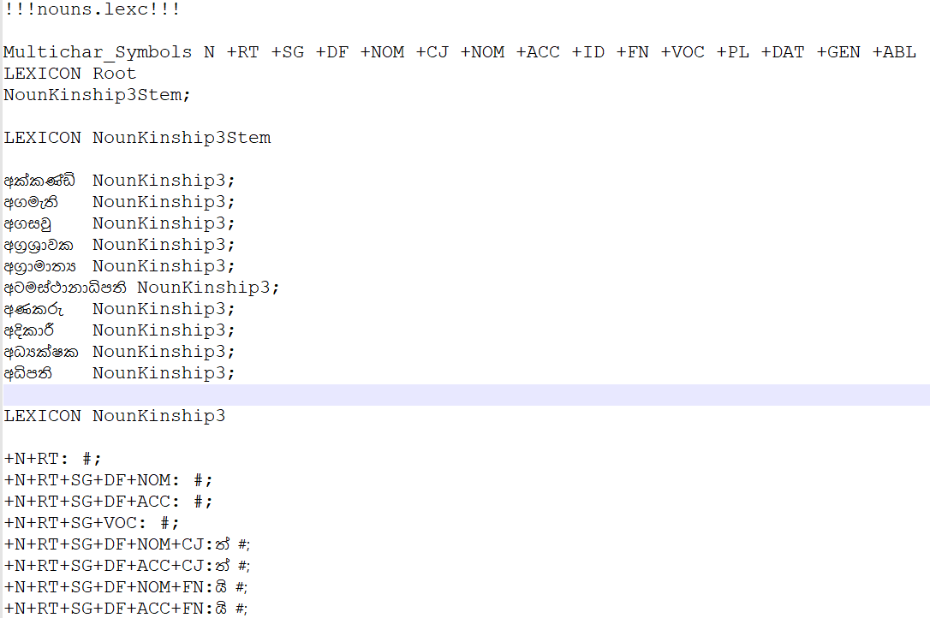
Example Foma class

Slide 36
Root Extractor
We only had 11000 sinhala noun root words from the earlier researches. To increase the accuracy of the morphological analyser we had to add more root words to the above declared classes.
We developed a Root extractor script to extract root words from a corpus.
We used the tagged corpus of 10 M words and extracted 8000 noun roots according to the inflections used in developing the morphological analyser.
After generating root words they are categorized into above 26 classes from this root extractor.

Slide 37
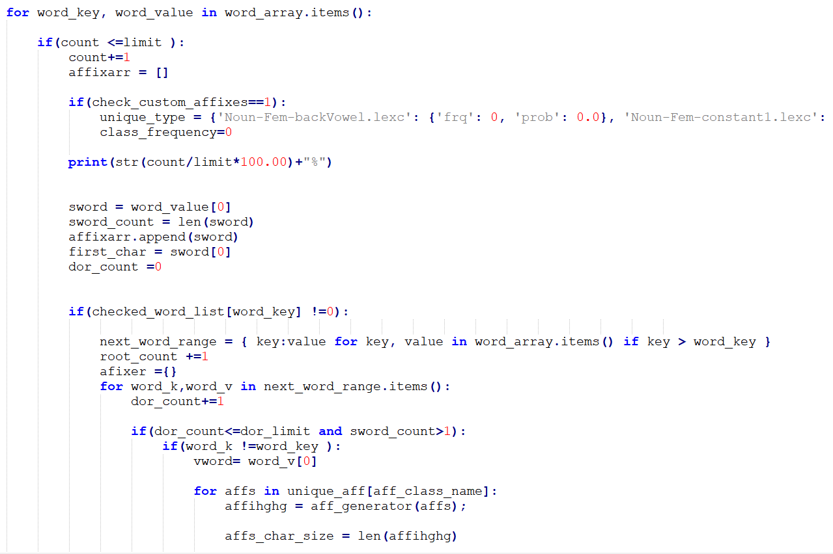
Main code of the root extractor

Slide 38
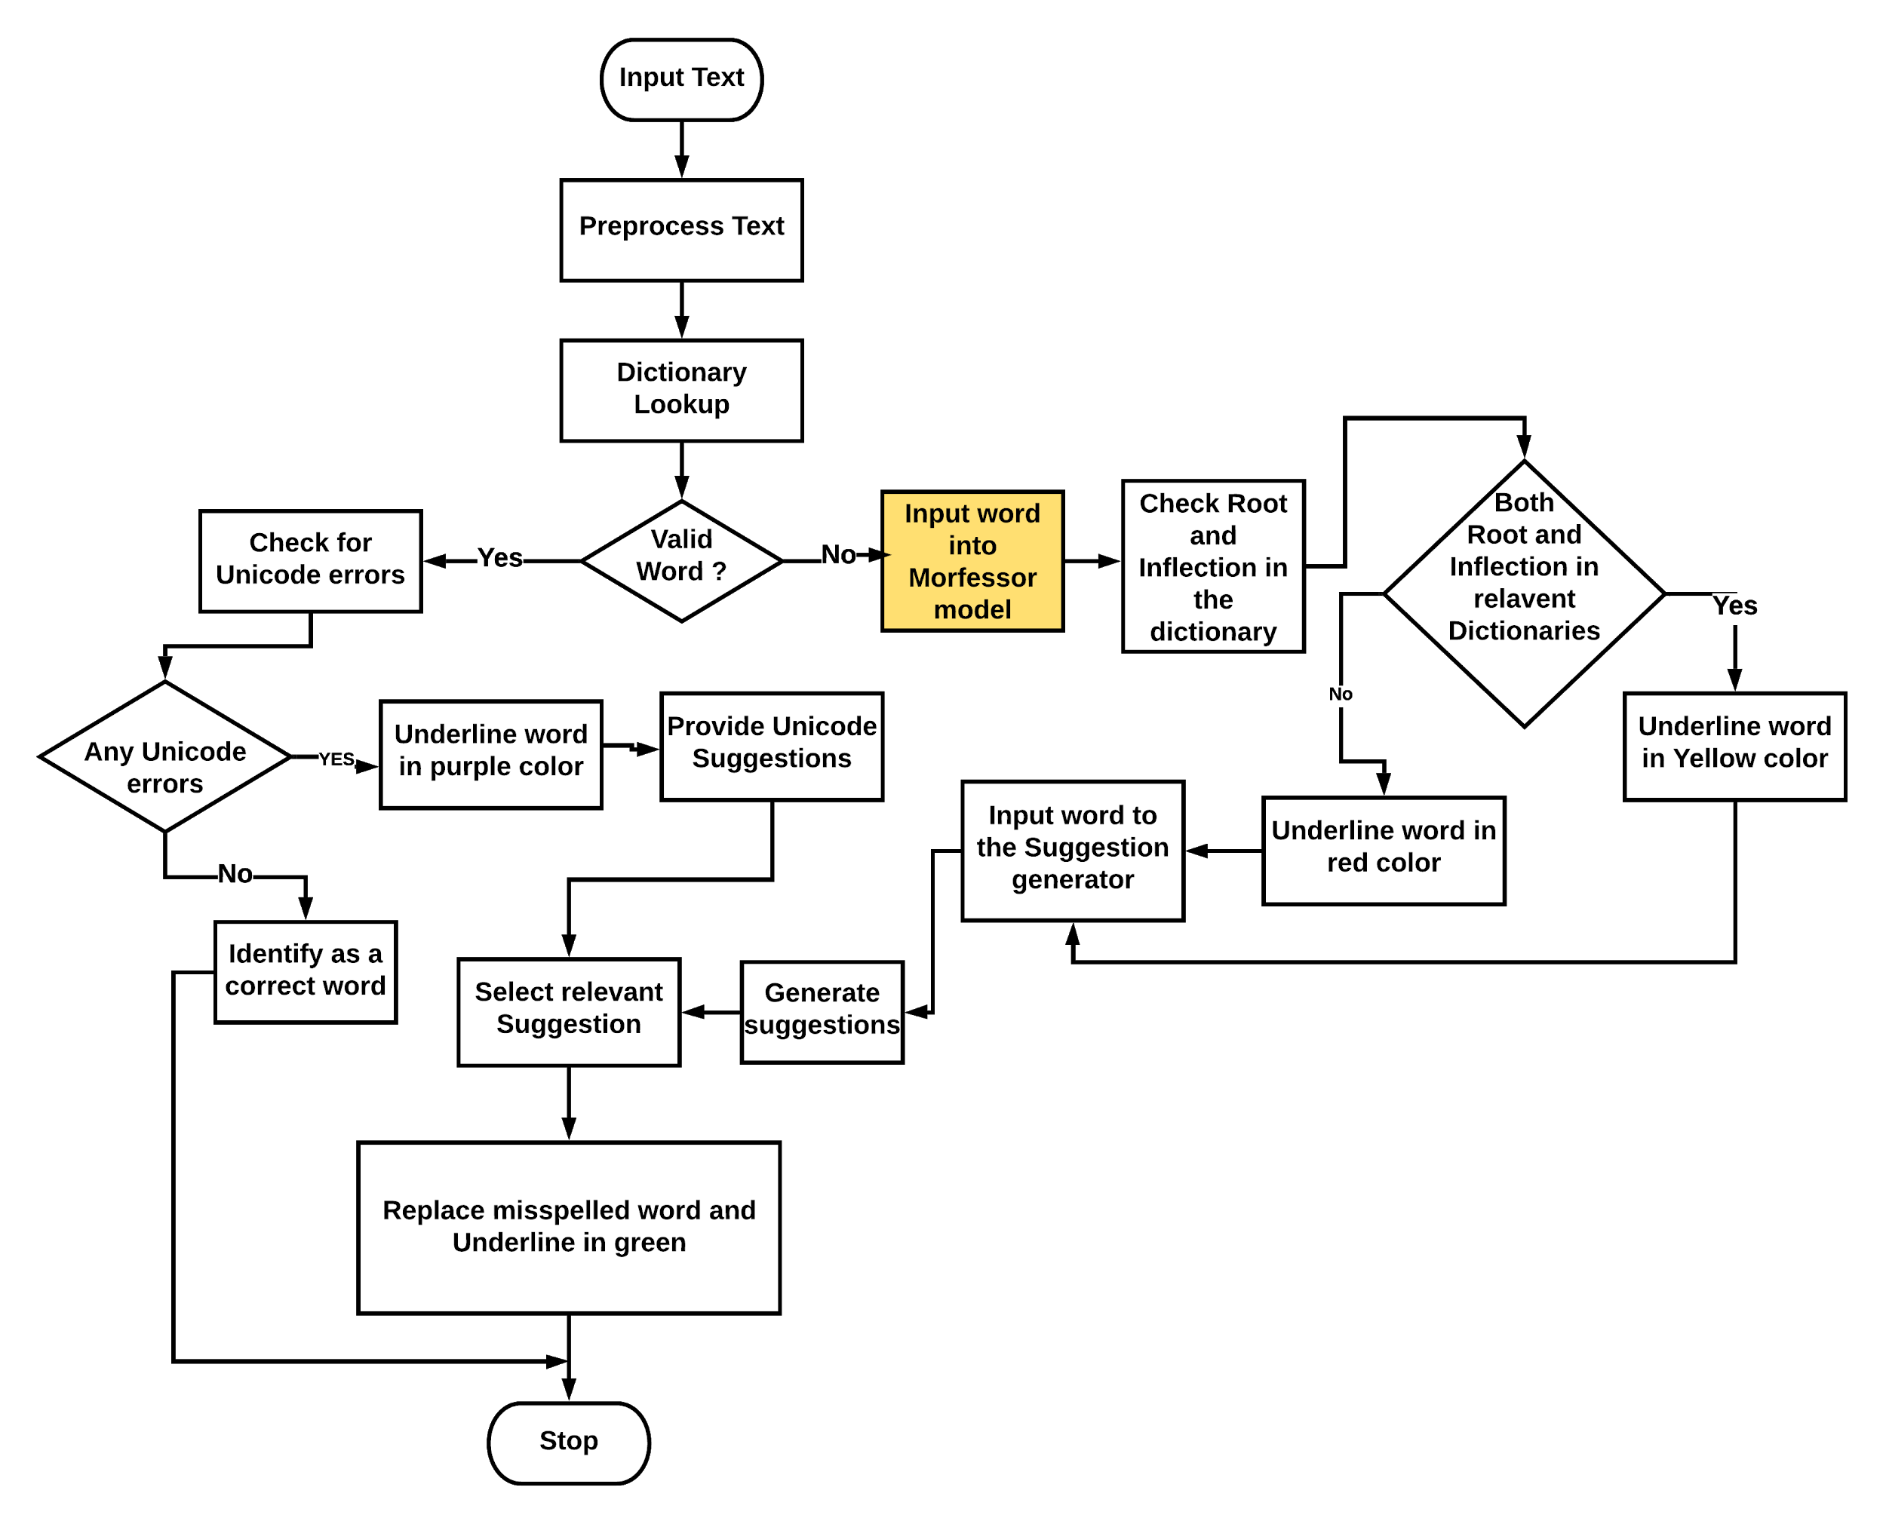

Slide 39
Morfessor Model
We created a dataset of 400k sinhala words and romanized that dataset ( converting into english script using a script) to train a morfessor model and tested with a test set that we created using golden standards for sinhala language.
We got close to 70% accuracy from the morfessor model for stemming the root words and inflections for the test set.
Using morfessor model will improve the overall accuracy of spell checker because it can identify new inflected words that are not in the dictionary.
Notes:
When evaluating the application after completing the spelling error detection part we identified that lots of inflected correct words were not identified as correct words because they were not in the dictionary. But when we analyse the dictionary we saw that root words of those inflected words which were not identified, were in the generated dictionary. When we researched and brainstormed about how to resolve this issue we came up with the idea of using morfessor algorithms in our project.

Slide 40
Morfessor Model
First we check if a given word to the application, is in the default dictionary.
If that word is not in the dictionary we send that word into the morfessor model to break that word in to the root word and inflection (morpheme segmentation).
Then we get the root word and the inflected part from the morfessor output and check both the parts in relevant dictionaries.
Check root part in master dictionary
Check Inflected part in inflections dictionary with 5000 inflections
If both the root part and the inflected part is in the relevant dictionaries we highlight that word in yellow color meaning that word might have some possibility of being a correct word ( close to 70%)

Slide 41
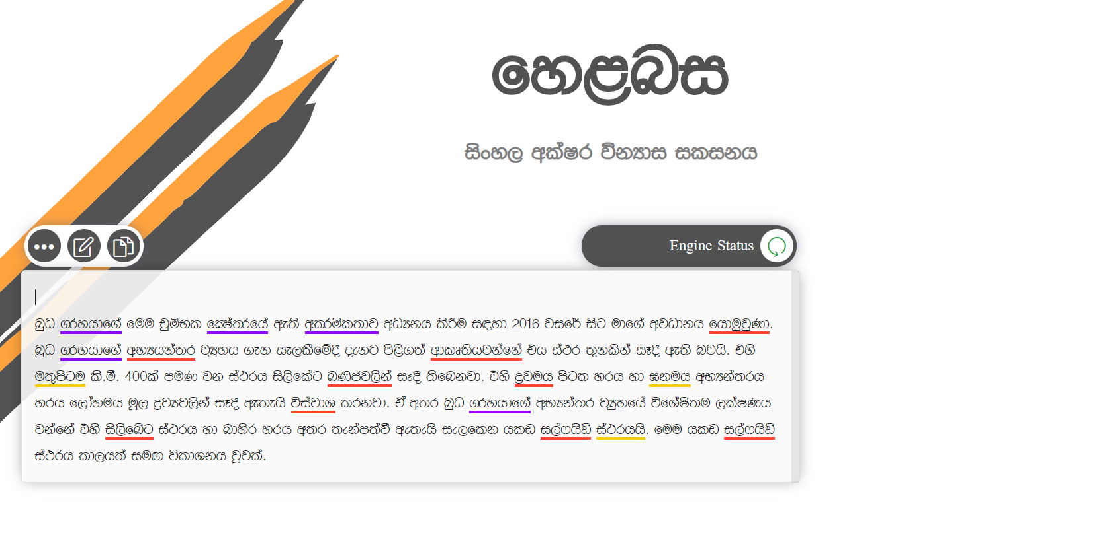

Slide 42
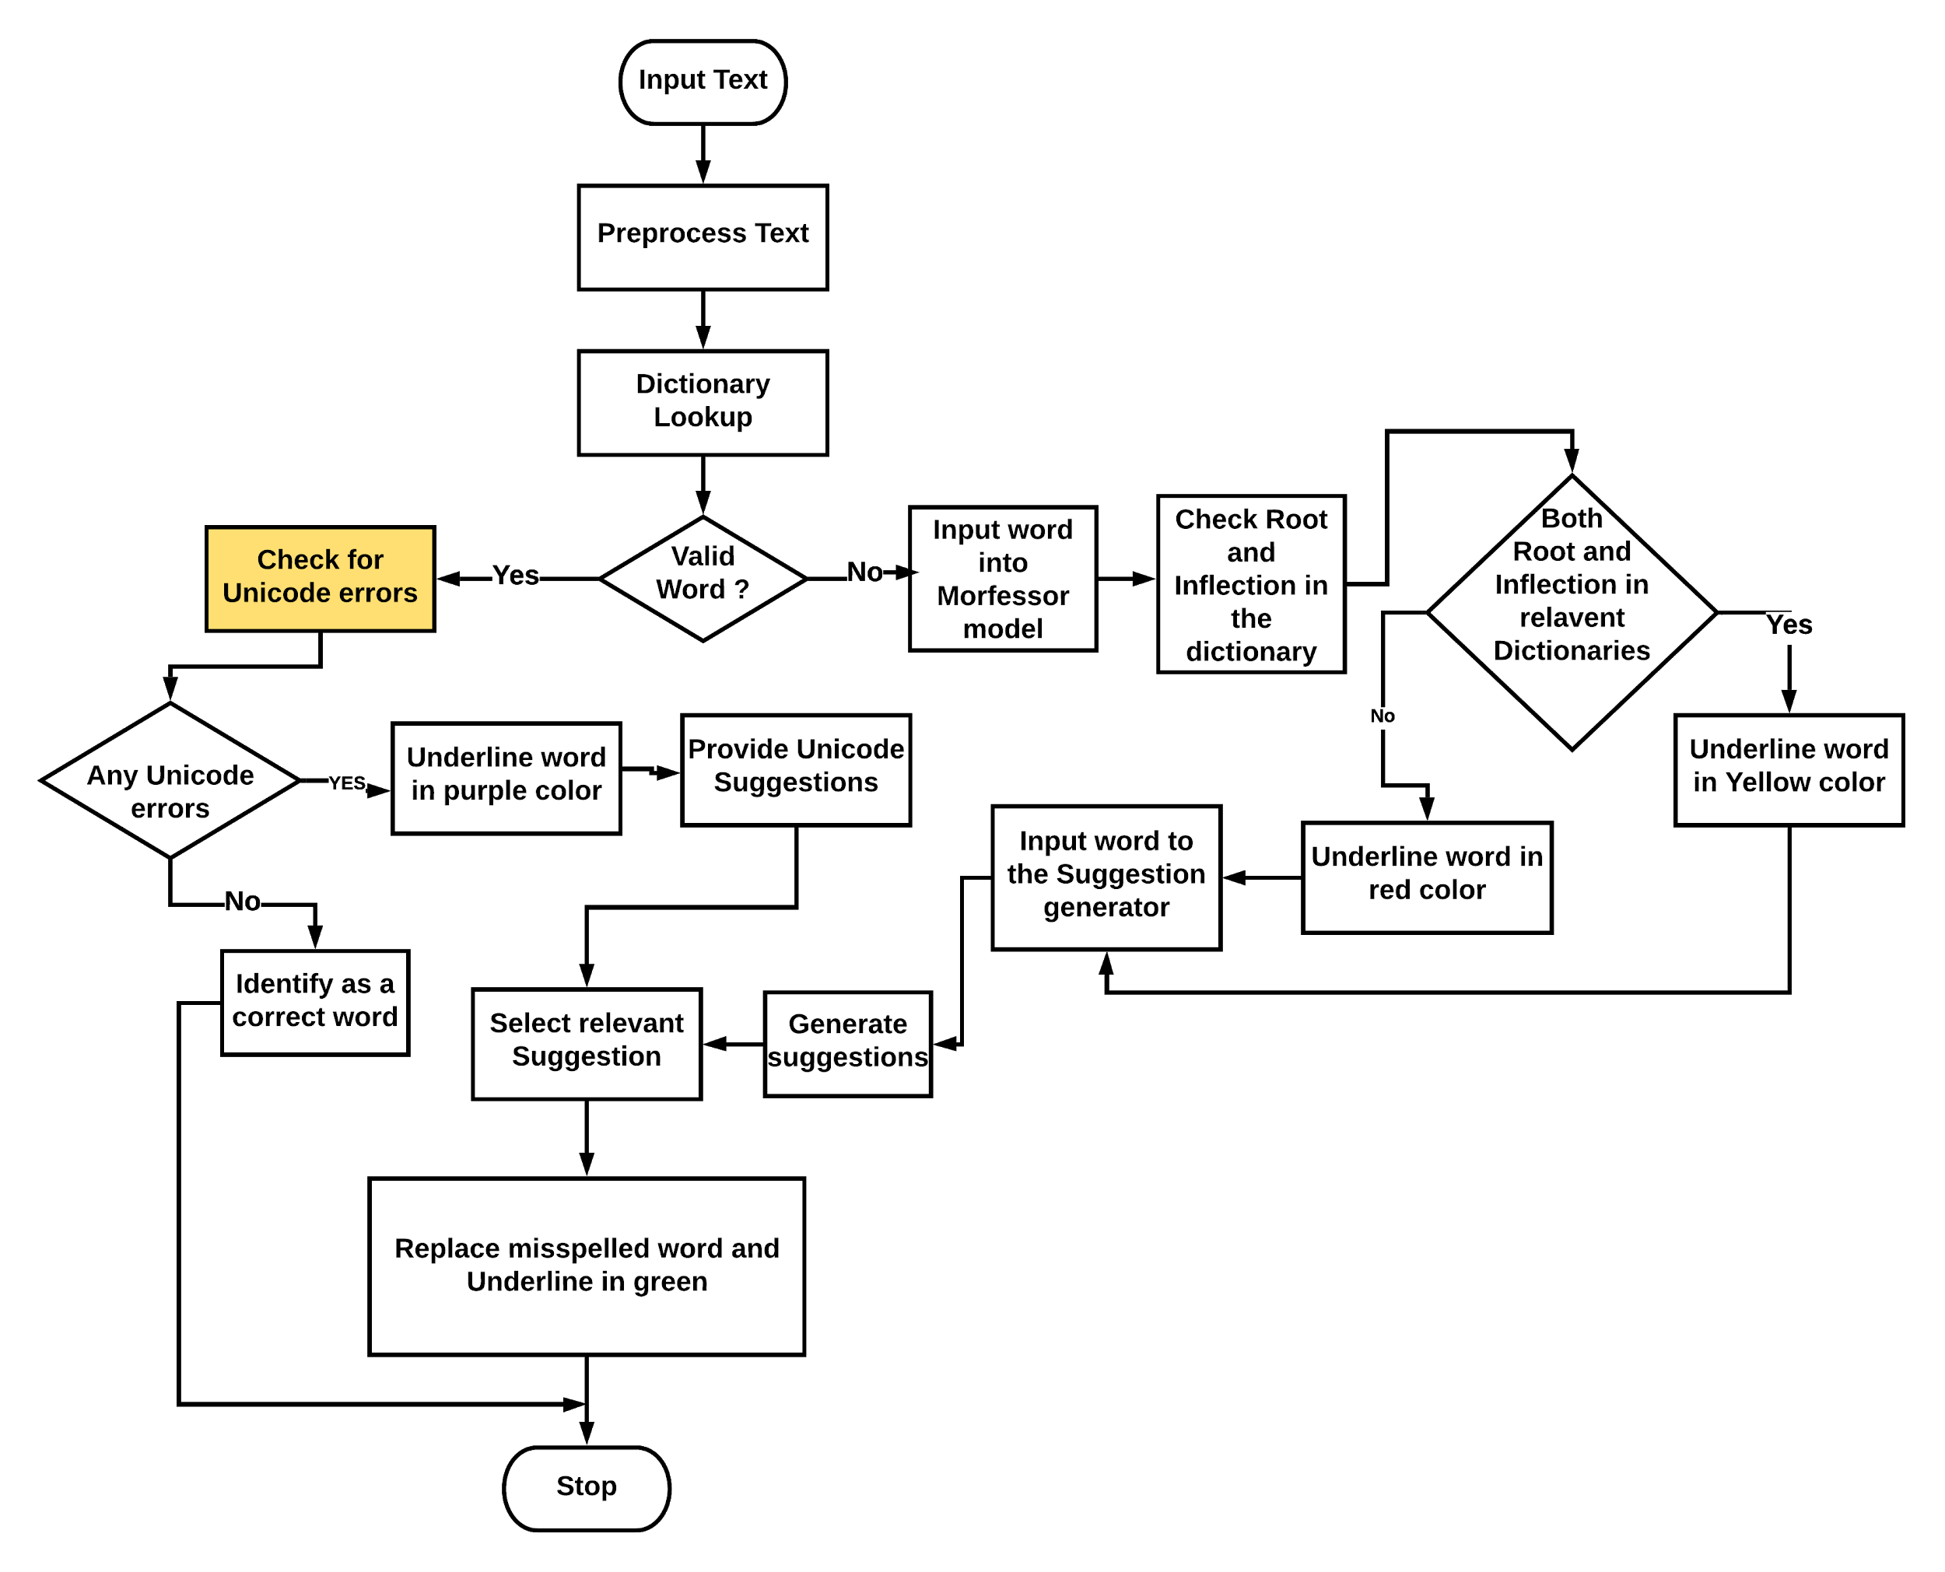

Slide 43
Unicode Error Detector
Input text is cleaned using above mentioned Unicode cleaner component.
When cleaning each word consisting with a unicode error can be identified. (Consisting of invisible character joiners such as zero width joiner (\u200d). )
After cleaning if that word is identified as a correct word ( word is in the dictionary) word is underlined in purple color to show that there is a unicode error.
When user clicks on that word, Unicode error is shown with invisible character and the cleaned and corrected word also shown as a suggestion

Slide 44
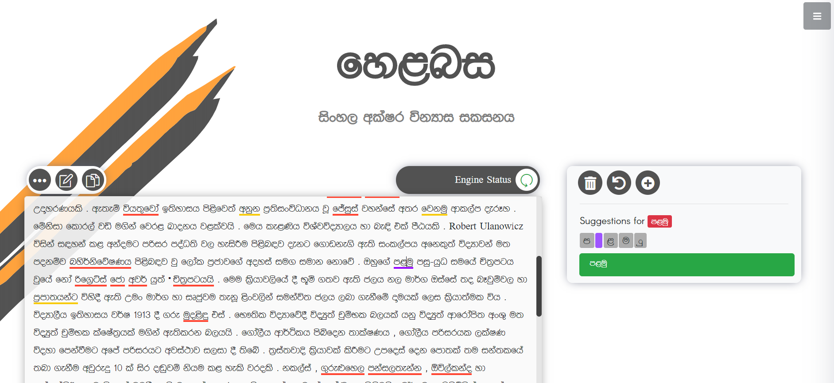

Slide 45
All Underlined Word Types
Word Type | Underlined Color | Suggestions Available
Incorrect | RED | YES
Corrected | GREEN | NO
Probably Correct | YELLOW | YES
Unicode Error | PURPLE | YES (Error fixed)

Slide 46
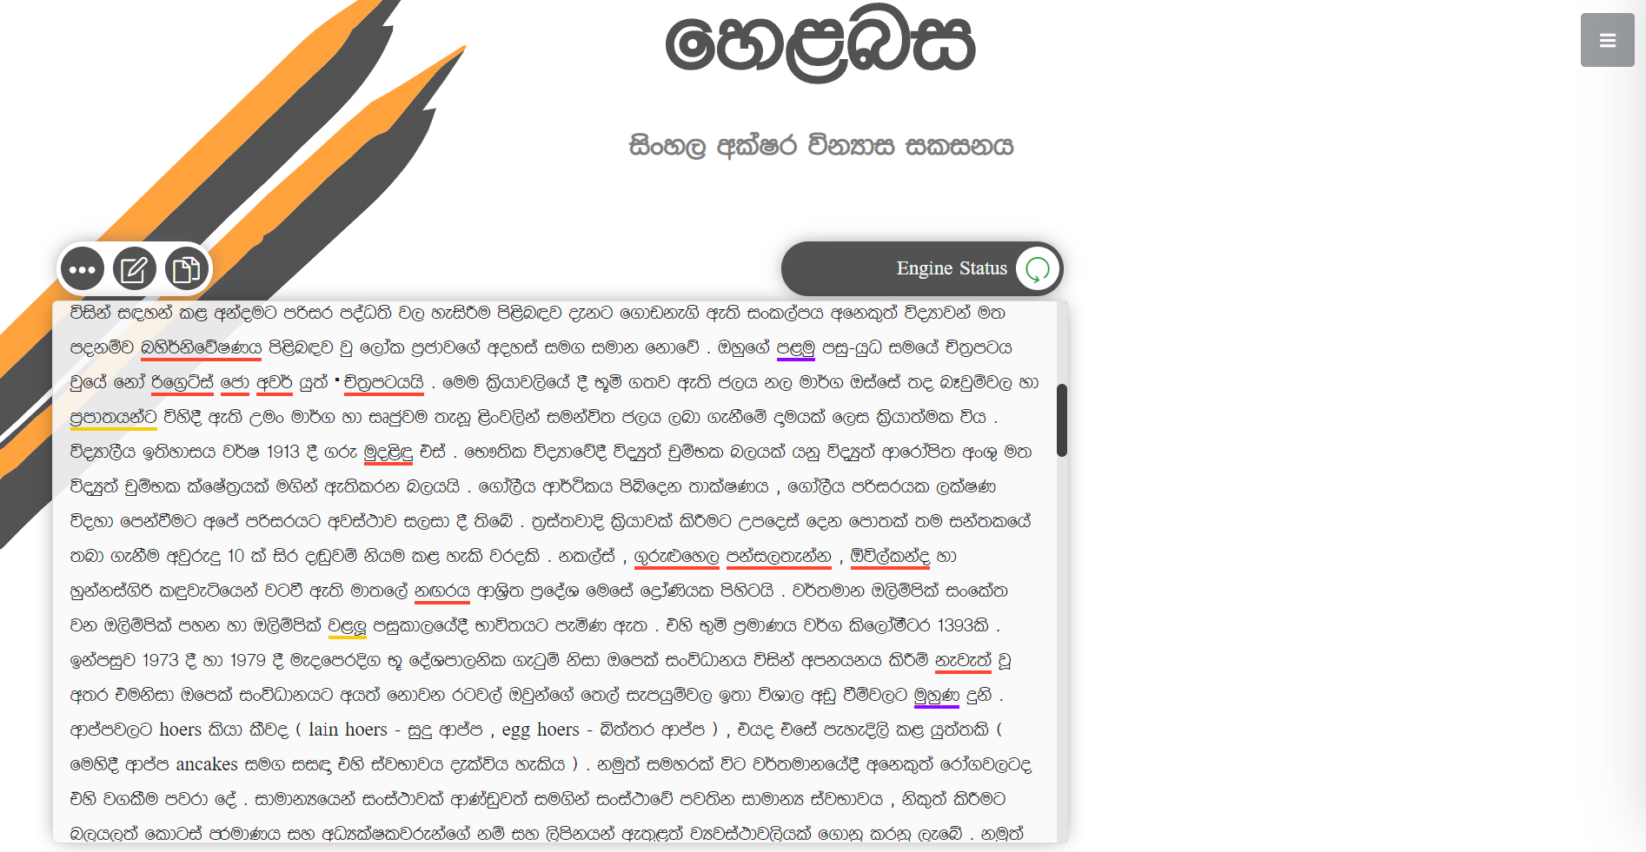

Slide 47
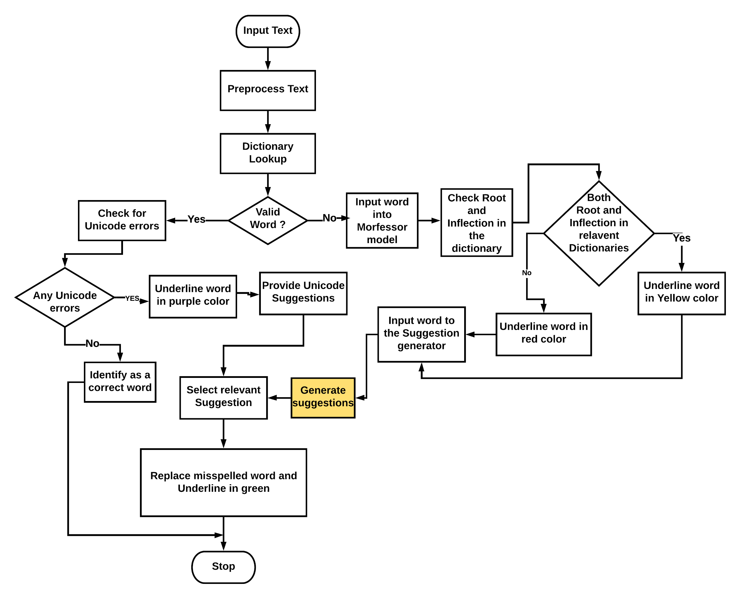

Slide 48
Suggestion Generator
Suggestion Generation
Most of the suggestion generators use minimum edit distance and n-gram based methodologies which consumes lot of time to generate suggestions.
Instead of those traditional methods we trained a machine learning model to output the closest syntactically similar words for a misspelled word
An error model was developed in order to score the words based on factors like frequency, minimum edit distance and the type of spelling error to get the best suggestion

Slide 49
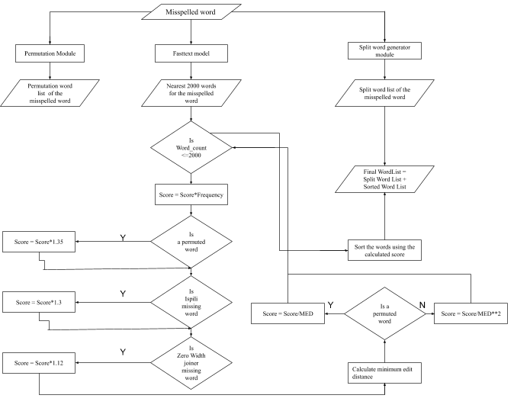

Slide 50
Suggestion Generator Modules
Consist of 4 main modules
Fasttext based module
Permutation generation module
Split Word generation module
Error module

Slide 51
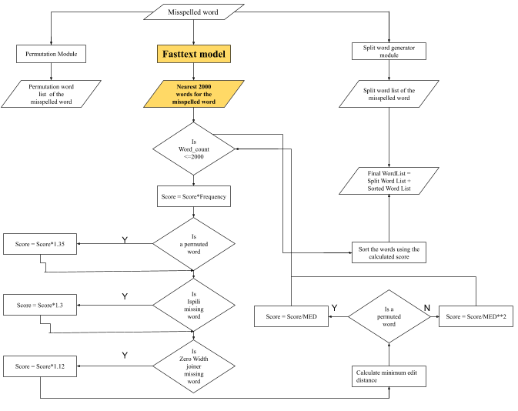

Slide 52
Fasttext Module
Reasons for selecting fasttext model
Ability to generate word vectors for out of vocabulary words(misspelled words can be out of vocabulary)
Ability to calculate nearest neighbors quickly for a given word
Use of subword information which can improve the syntactic similarity of the words

Slide 53
Fasttext Module
Data Preprocessing
Used a text corpus which we created by collecting data from Sinhala monolingual corpus available on WMT19
Tagged corpus available in the DMS also used to increase the word count. It also contained around 10M words.
After filtering out the Sinhala words total word count was around 110M

Slide 54
Fasttext Module
Model Selection
2 unsupervised algorithms that can be used to generate word representation given a corpus.
Cbow
Skipgram
Trained 2 models with default parameters using the 2 algorithms.
Model Training
Parameter | Changed Value
dim | 300
minn | 2
maxn | 7
Notes:
As mentioned in the literature review each algorithm possesses a unique set of features that can be useful according to the use case as well as according to the used language. So, we wanted to select the algorithm for the Sinhala language to get the best word representation highlighting the syntactic similarity of the words.

Slide 55
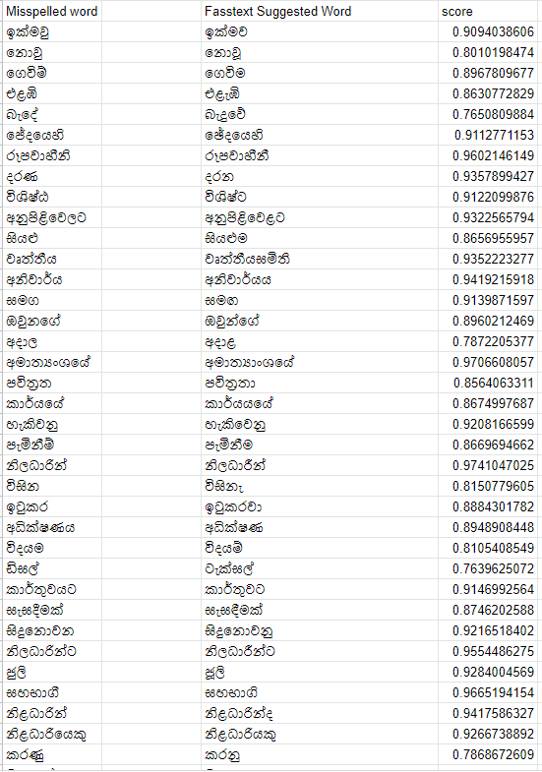

Slide 56
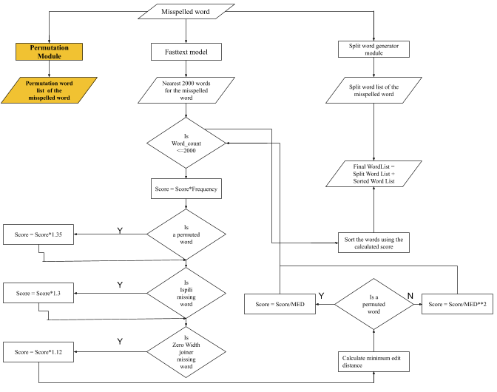

Slide 57
Permutation generation module
Spelling errors caused due to phonetic similarity of the letters can be considered as one of the most common types of spelling errors in the Sinhala language. Similar sounding groups of letters are as follows.
{න,ණ} {ල, ළ} {ස, ශ, ෂ} {ත, ථ} {බ, භ} {ද, ධ} {ඳ, ද} {ට, ඨ} {ච, ඡ} {ජ} {ක, ඛ} {ග, ඝ} {ජ, ඣ} {ප, ඵ} {ඩ, ඪ}
For example given the word බල්ළා;
module will generate : බල්ලා, බළ්ළා, භල්ළා, බළ්ලා, භල්ලා, භළ්ළා, භළ්ලා
Generated permutations will be filtered by the spell corrected dictionary

Slide 58
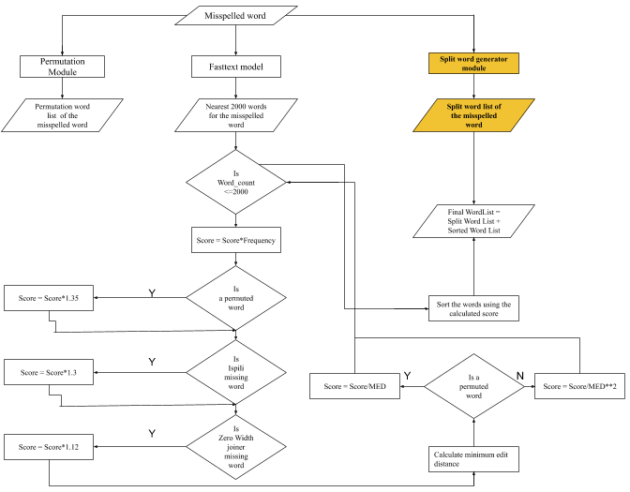

Slide 59
Split word generation module
Most of the time when users type something they tend to forget to insert a space between two words.
Although the two words are correct separately the spell checker detects the word as an incorrect word due to missing space.
So this module tries to split a given misspelled word into 2 correctly spell words.
As an example given the misspelled word අංගසම්පූර්ණඅකාර්යක්ෂම, the module should split it into 2 correctly spelled words as අංගසම්පූර්ණ and අකාර්යක්ෂම.
Module uses nearest-neighbor output words from the fasttext model.

Slide 60
Error Module
In order to identify the most common spelling mistakes, a test set of 457 words were chosen randomly
Error | Count | Percentage
Nana Lala Error | 148 | 32.2%
Ispili Papili Missing Error | 135 | 29.5%
Joiner Missing Error | 58 | 12.5%

Slide 61
Error Module
Edit Distance | Count | Percentage
1 | 312 | 68% | Insertion | 80
 |  |  | Deletion | 7
 |  |  | Substitution | 225
2 | 100 | 21% | insertion | 25
 |  |  | Deletion | 20
 |  |  | Substitution | 55
3 | 22 | 0.04% | Insertion | 7
 |  |  | Deletion | 2
 |  |  | Substitution | 13
4 | 22 | 0.04% | Insertion | 10
 |  |  | Deletion | 2
 |  |  | Substitution | 10

Slide 62
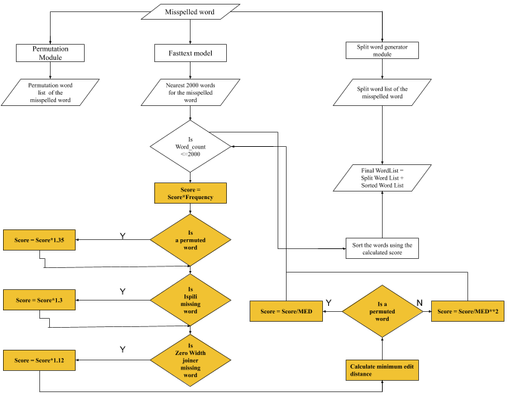

Slide 63
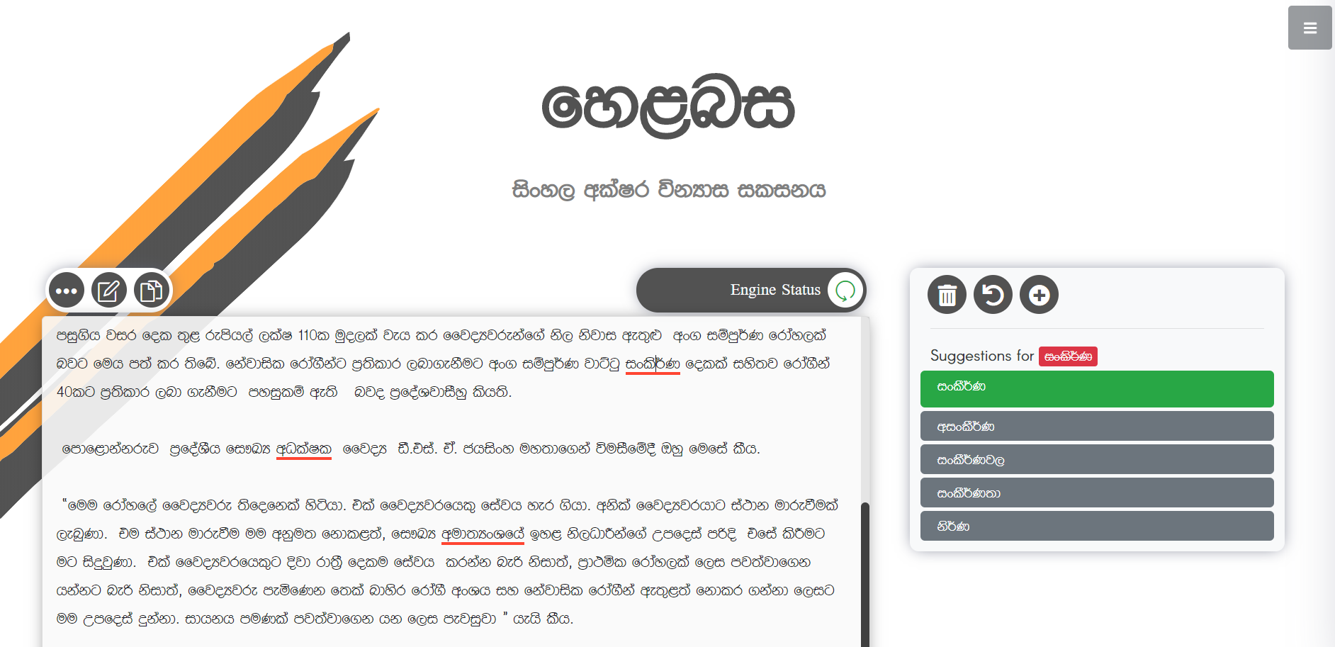

Slide 64
Results and Evaluation

Slide 65
Spell Checker
True Positive Accuracy
Out of 1000 words
Spell Checker | No of Correct Words Identified as correct words | No of Correct words identified as incorrect words | True positive percentage (Accuracy)
Helabasa | 969 | 31 | 96.9%
Microsoft Word | 834 | 166 | 83.4%
Hunspell | 794 | 206 | 79.4%
Subasa | 920 | 80 | 92%

Slide 66
Spell Checker
True Negative Accuracy
Out of 1000 words
Spell Checker | No of Incorrect Words Identified as Incorrect words | No of Incorrect words identified as correct words | True Negative percentage (Accuracy)
Helabasa | 910 | 90 | 91%
Microsoft Word | 924 | 76 | 92.4%
Hunspell | 855 | 145 | 85.5%
Subasa | 472 | 528 | 47.2%

Slide 67
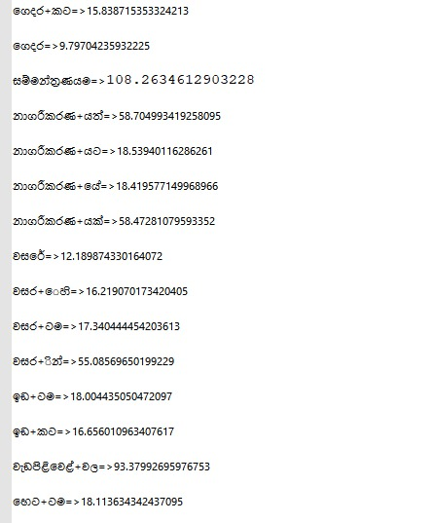
Morfessor
100 words underlined in yellow color by the morfessor were used
Out of the 100, 72 words were manually analysed and verified as correct words
Probability of yellow underlined word being a correct word is 0.72

Slide 68
Suggestion Generator
Suggestion generation accuracy of Helabasa
Misspelled words extracted from DMS corpora
Misspelled words extracted from Youtube and Lankadeepa comments
 | Number of Misspelled Words | Correctly classified | First suggestion accuracy | MRR
1 | 200 | 171 | 80.53% | 0.8889
2 | 100 | 100 | 68% | 0.7803

Slide 69
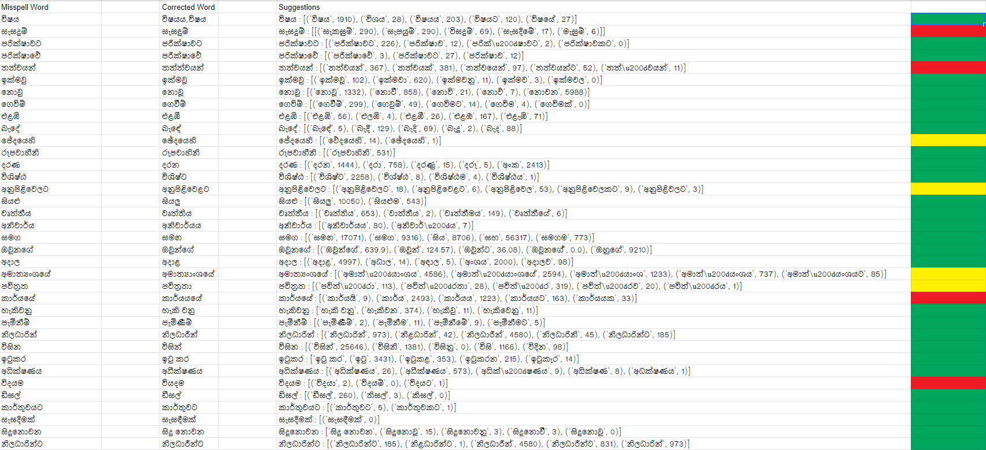

Slide 70
Suggestion Generator
Compared with Standard spell checkers
Misspelled words extracted from DMS corpora
 | Number of Misspelled Words | Correctly classified | First suggestion accuracy | MRR
Word | 200 | 188 | 52.12% | 0.5717
Hunspell | 200 | 171 | 58.4% | 0.6227
Subasa | 200 | 94 | 77.65% | 0.7765

Slide 71
Suggestion Generator
Compared with Standard spell checkers
2. Misspelled words extracted from Youtube and Lankadeepa comments
 | Number of Misspelled Words | Correctly classified | First suggestion accuracy | MRR
Word | 100 | 98 | 35.71% | 0.4319
Hunspell | 100 | 48 | 60.41% | 0.7176
Subasa | 100 | 38 | 73.68% | 0.7368

Slide 72
Work Carried Out

Slide 73
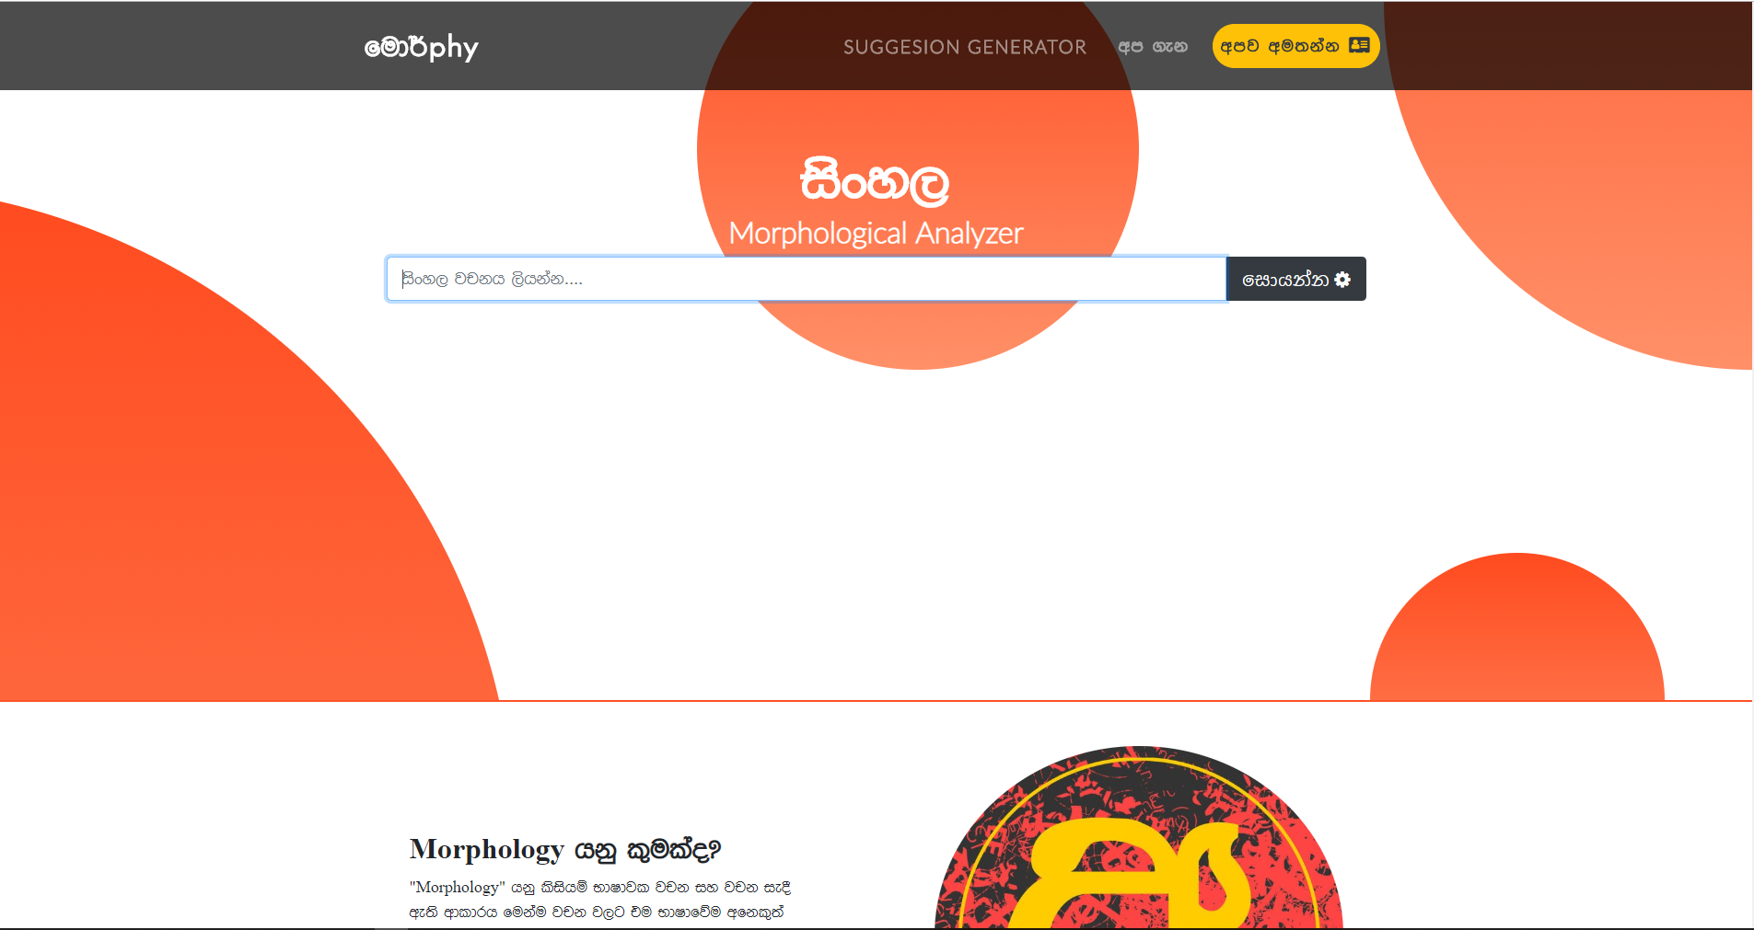
Noun Morphological Analyzer
Place your screenshot here
Used FOMA and PHP to develop a web based morphological analyzer for 600,000 nouns.
User can enter a noun and analyse the morphological information of the noun

Slide 74
Refined and Analyzed the Sinhala Corpara
It is vital to identify all the noun words from the corpora before developing the morphological analyzer.
Majority of the tagged corpora have some word tagging issues.
Having multiple tags for a given unique word
Some words in the corpora did not have any associative tag at all
Developed a python script to search and indicate tagging mistakes accurately for all of the possible tagging issues within corpora.

Slide 75

Challenges and Risks

Slide 76
CHALLENGES
Categorizing Sinhala nouns into Foma applicable categories
Finding resources as Sinhala is a resource scarce language
Finding resources that can train deep learning models
Limitations in Microsoft API to create spell checker add-in for Microsoft office word

Slide 77
REFERENCES
[1] R. W. R. P. C. L. a. E. J. Asanka Wasala, "A Data-Driven Approach to Checking and Correcting Spelling Errors in Sinhala," The International Journal on Advances in ICT for Emerging Regions, vol. 3.
[2] A. W. ,. W. Eranga Jayalatharachchl, "Data-Driven Spell Checking: The Synergy of Two Algorithms for Spelling Error Detection and Correction," The International Conference on Advances in ICT for Emerging Regions - iCTer , pp. 7-13, 2012.
[3] Subhagya, L.G., Ranathunga, L., Nimasha, W.H., Jayawickrama, B.R., & Mahaliyanaarchchi, K.L. (2018). Data Driven Approach to Sinhala Spell Checker and Correction. 2018 18th International Conference on Advances in ICT for Emerging Regions (ICTer), 01-06.S
[4] H. Kaur, G. Kaur and M. Kaur, "Punjabi Spell Checker Using Dictionary Clustering," International Journal of Science, Engineering and Technology Research, vol. 4, no. 7, pp. 2369-2374, July 2015.

Slide 78
REFERENCES
[5] G. U. M. Rao, P. A. Kulkarni and C. Mala, "A Telugu Morphological Analyzer," International Telugu Internet Conference Proceedings, 28th - 30th September 2011.
[6] B, Premjith & Kp, Soman & Kumar, M. (2018). A deep learning approach for Malayalam morphological analysis at character level. Procedia Computer Science. 132. 47-54. 10.1016/j.procs.2018.05.058.
[7] Sooraj, S & K, Manjusha & Kumar, M & Kp, Soman. (2018). Deep learning based spell checker for Malayalam language. Journal of Intelligent & Fuzzy Systems. 34. 1427-1434. 10.3233/JIFS-169438.
[8] Bojanowski, P., Grave, E., Joulin, A. and Mikolov, T., 2017. Enriching word vectors with subword information. Transactions of the Association for Computational Linguistics, 5, pp.135-146.
[9] Welgama Viraj, Weerasinghe Ruvan, and Mahesan Niran (2015) 'Deﬁning the Gold Standard Deﬁnitions for the Morphology of Sinhala Words', Research in Computing Science , 90(), pp.

Slide 79
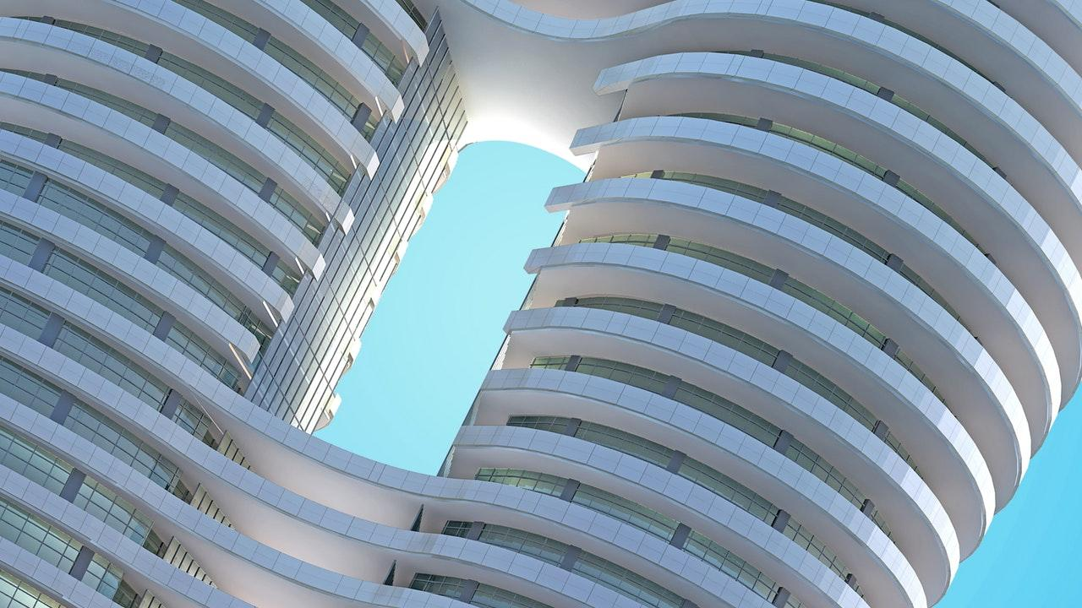
THANKS!

